Slide 1
Week 8 Modalities

Slide 2
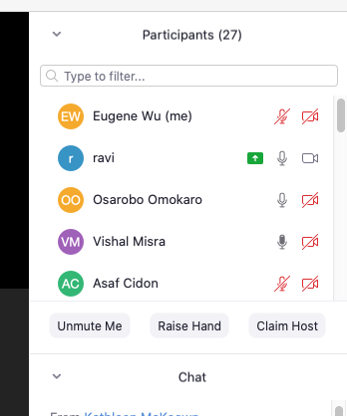

Administrivia
Keep microphone muted
Hold space bar to unmute while talking
Keep video on
Raise hand to discuss
Click participants
Click raise hand

Slide 3
Administrivia
Last class before spring break
Stay healthy, stay safe
A3 will be released this Friday
Project check-ins Week of march 25. Sign up from website

Slide 4
GestureQuery
Presenter: Carmine Elvezio
Scribe: Richard Zhang
SpeakQL
Presenter: Eugene Wu
Scribe: Alex Price

Slide 5
GestureQuery Discussion

Slide 6
Questions
What did you like about the writing?
New ideas need lots of motivation
Provides vocabulary to talk about the problem space
Query specification, intent, context, session, gesture, feedback
Defines desiderata to provide a measure of success
What did the paper not discuss in detail?
Systems performance
What does usability mean in this paper?

Slide 7
Experiments
What did you think? Were the experiments “fair”?
Evaluated user timing and prefs for individual operators
Gesture classifier accuracy
Discoverability only for Join
Filter is harder than Join
What about end-to-end tasks?

Slide 8
Issues/limits of GestureQuery?
Feedback can be expensive to provide on larger data
Complex queries harder to compose

Slide 9
SpeakQL

Slide 10
The SpeakQL argument
People
know SQL. May even be experts
want to write SQL on-the-go
have a phone/tablet
Thus speech interface is best

Slide 11
Use Cases
DBA debugging system while on the road
Nurse accesses patient record away from his desk
Analyst answers customer sales question in a meeting

Slide 12
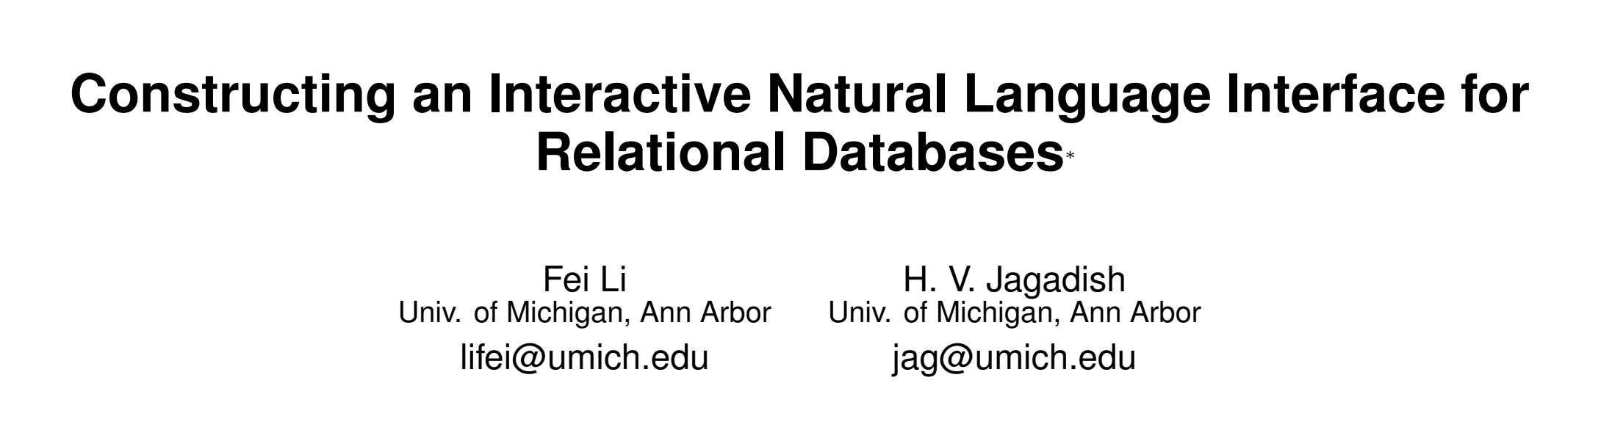
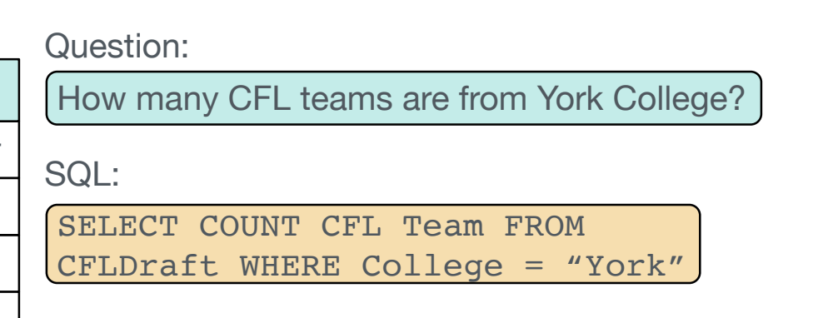
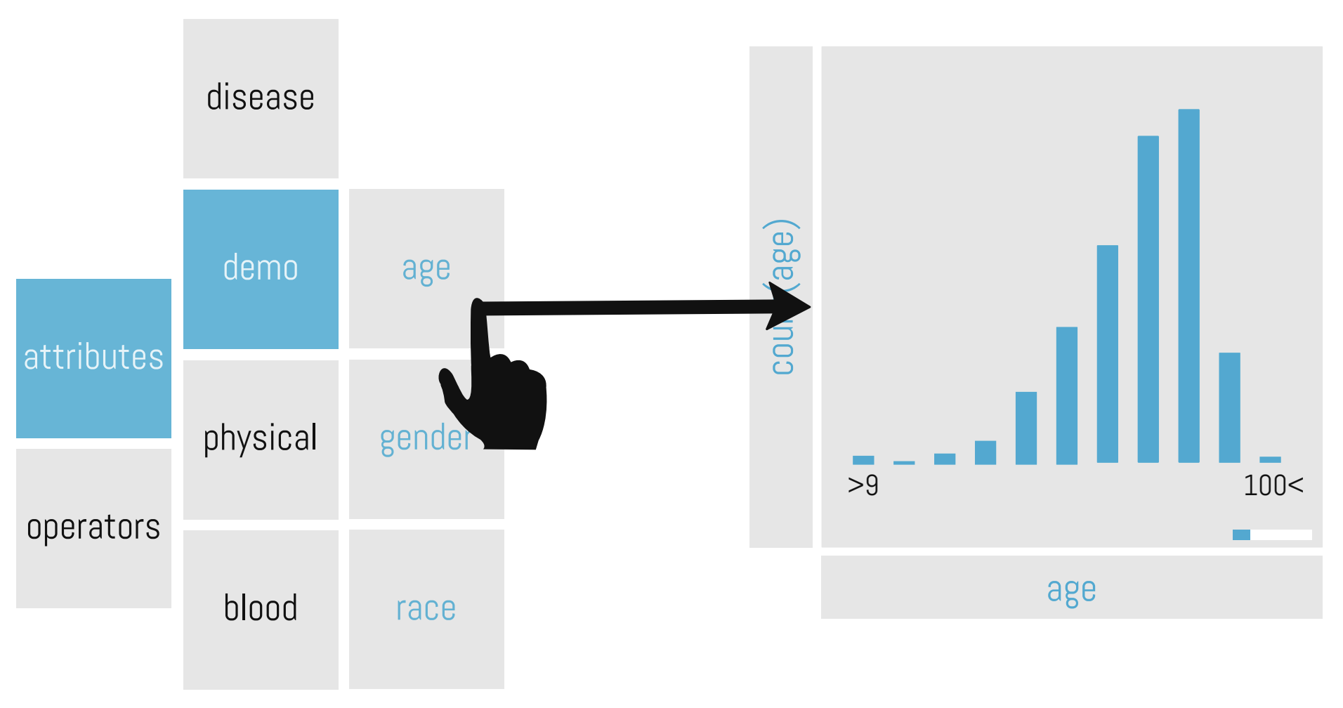
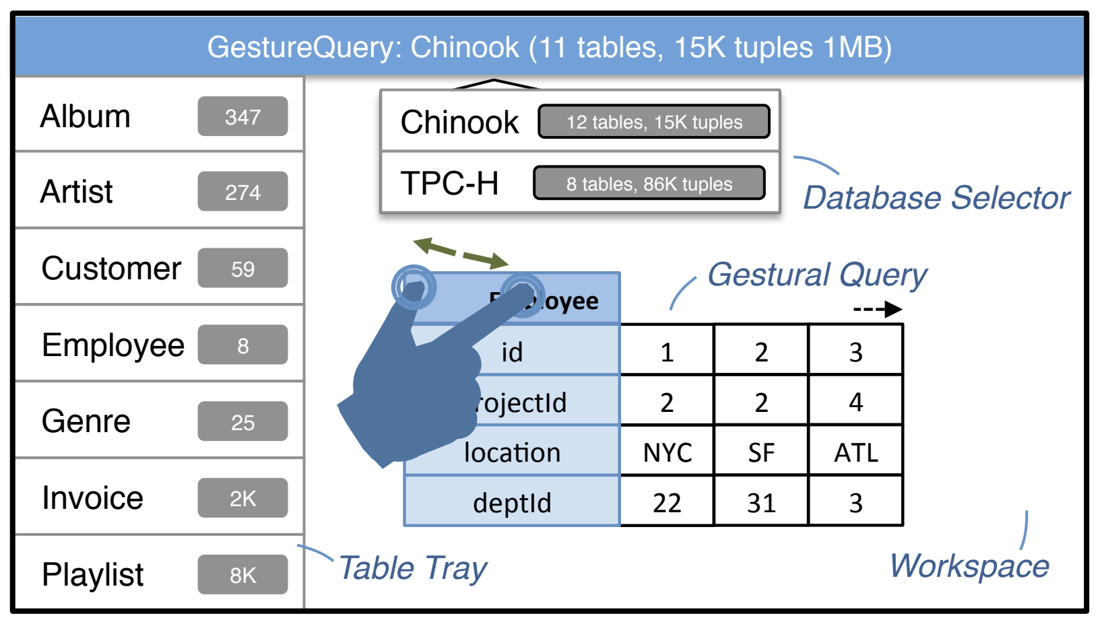
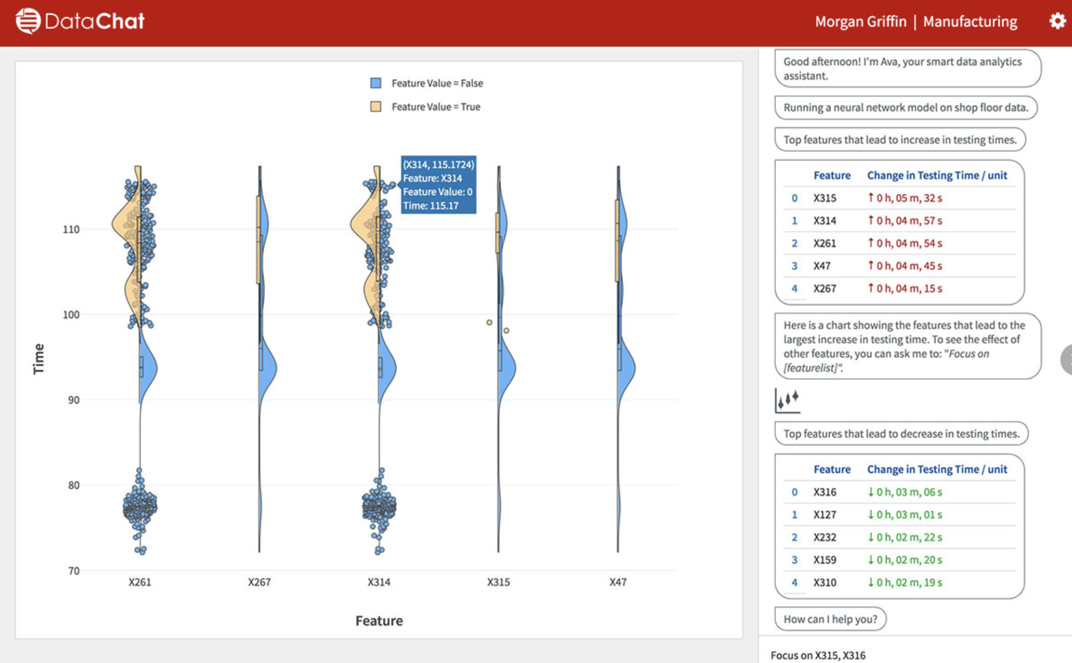
Why Not Existing Approaches?
Natural Language Interfaces (NLI)
User speech → ASR → NLI → SQL → result
Errors propagate in each step
Touch interfaces
Paper argues they “obviate” SQL
Template-based Interfaces
Seq2SQL
vizdom
gesturequery
DataChat

Slide 13
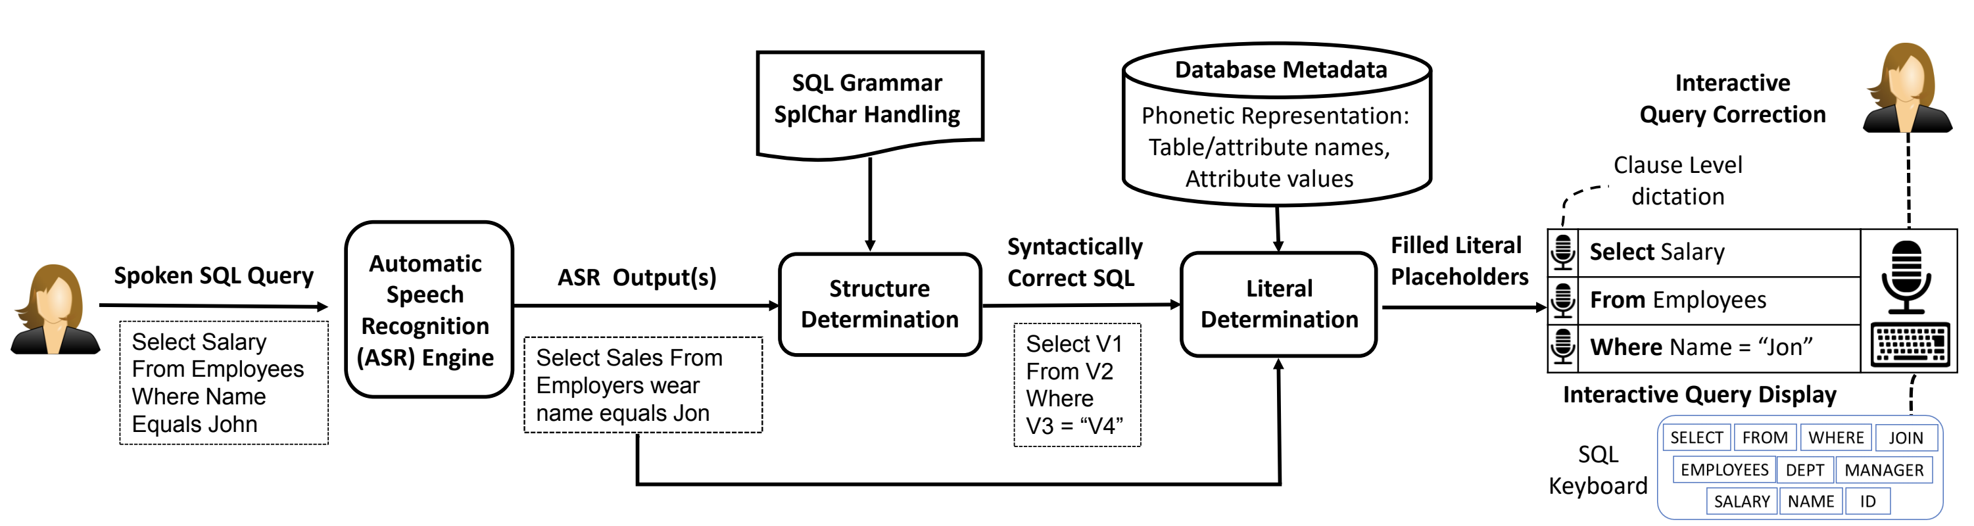
Approach Overview
Match speech tokens to SQL template (struct determination)
Fill in literals, address homophones (literal determination)

Slide 14
Structure Determination
Goal: find matching query template
Offline: build index of all possible query templates
Online: find minimum edit distance query template

Slide 15
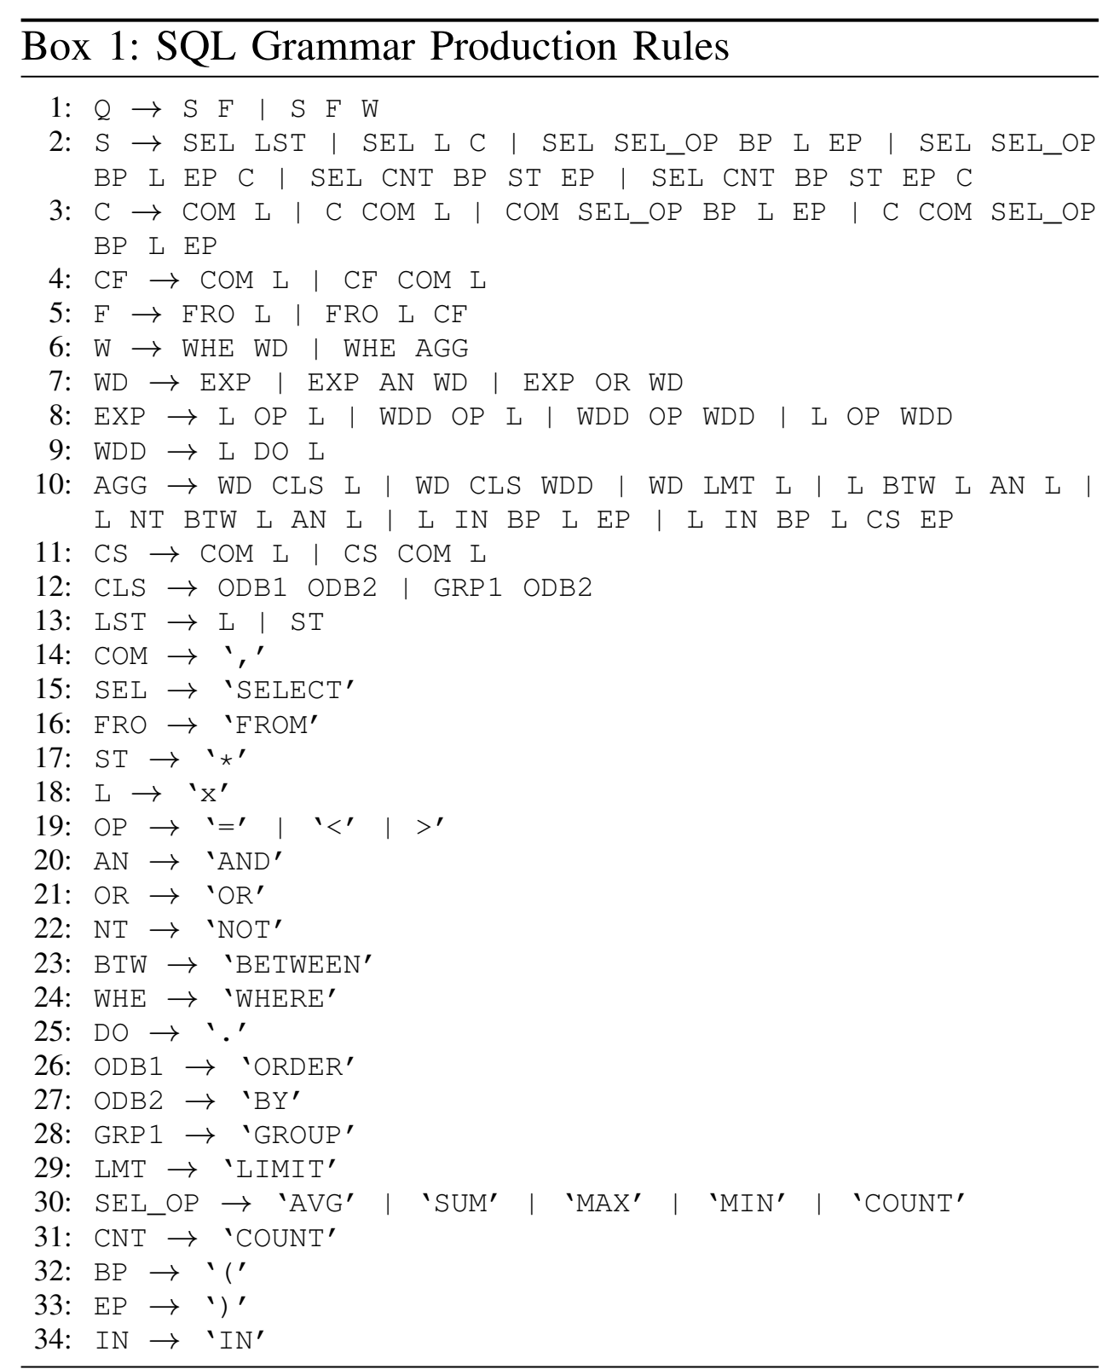
Offline
Generate all queries <=50 tokens
Build trie for queries of same length

Slide 16
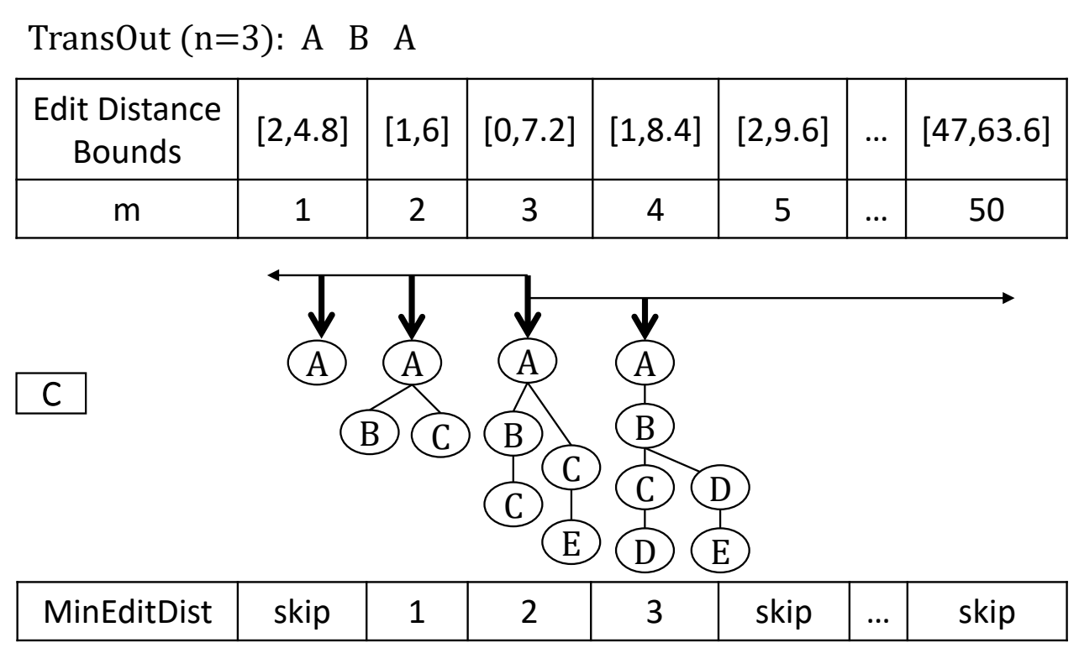
Online
Find template that matches
“select first name from employers wear col one two equal jon”
to
SELECT v1 FROM v2 WHERE v3 = v4
Match by edit distance
Bound & prune trick to speed up

Slide 17
Literal Determination
Fill in variables in query template based on sounds-like-ness
“select first name from employers wear col one two equal jon”
to
SELECT v1 FROM v2 WHERE v3 = v4
Ideas
Translate all tokens & values into phonemes. Employees → EMPLYS
Infer variable types from grammar. v1 is attr, v2 is table
Know tokens to variable mappings. “first name” → v1

Slide 18
Literal Determination
Tricky part: picking the attribute name/values
“first name” → “firstname”
“col one two” → “col_12”

Slide 19
Literal Determination Example
Speech Tokens
Attribute Names
first
firstname
name
forestname
firstname
dates

Slide 20
Literal Determination
Tricky part: picking the attribute name/values
“first name” → “firstname”
“col one two” → “col_12”
What SpeakQL does
Enumerate all concatenations of tokens: ”first” “name” “firstname”
Compute phoneme distance with attributes “firstname”, “forestname”
All tokens get a “vote”
Thoughts on their method?

Slide 21
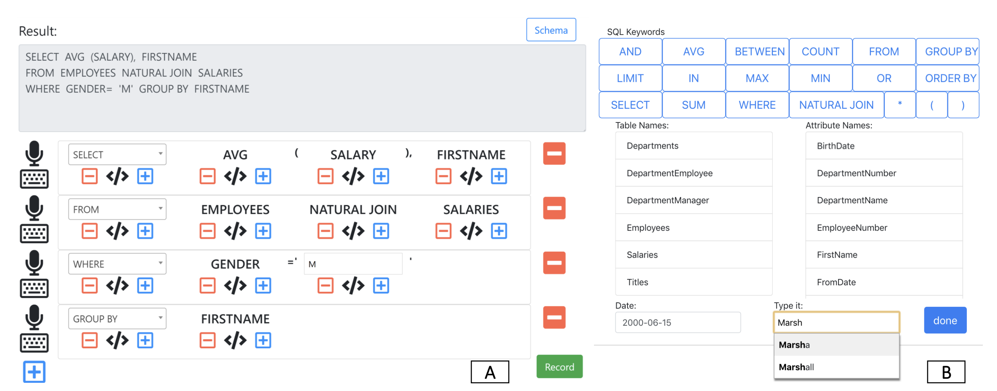
Experiment Setup
How accurate?
Did it get the tokens right?
Token edit distance
Easy to use?
Token edit distance
Time

Slide 22
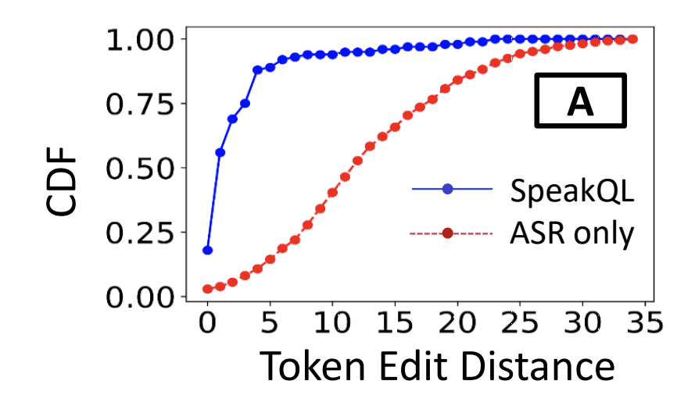
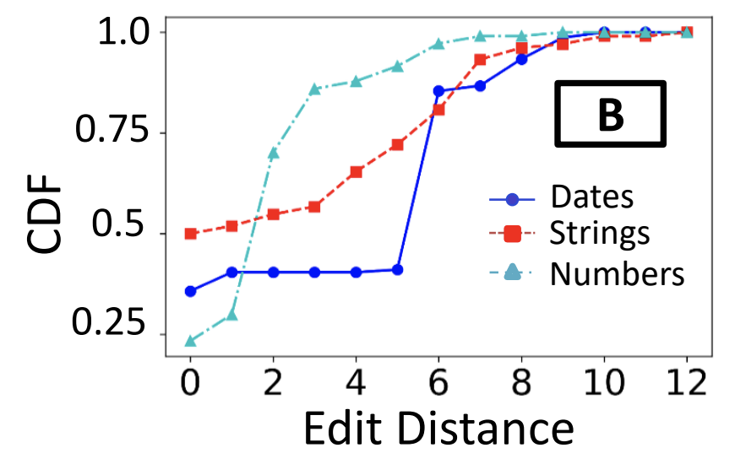
Synthetic Speech
Most within 5 tokens away from truth. Some within 25-30.
How complex are the queries? Does that matter?

Slide 23
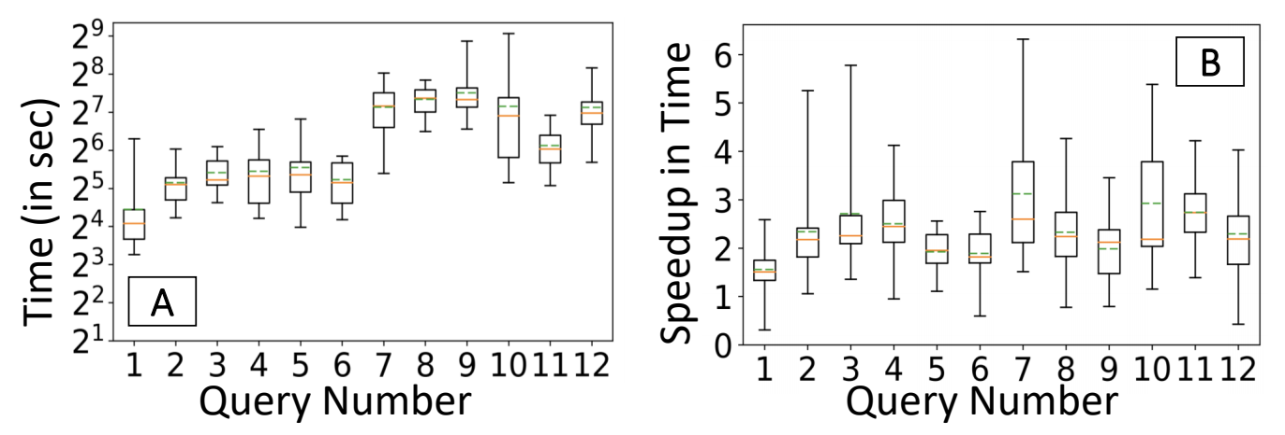
User Study
12 queries per user. 15 users
Simple: <20 token query
Complex: >= 20
Methods
SpeakQL
Mobile typing

Slide 24
Conclusions
SpeakQL works
Hard to compose entire query at once. Users think in “clauses”
Hard to disambiguate values – esp numbers and dates
Better than generic mobile keyboard typing

Slide 25
SpeakQL Discussion

Slide 26
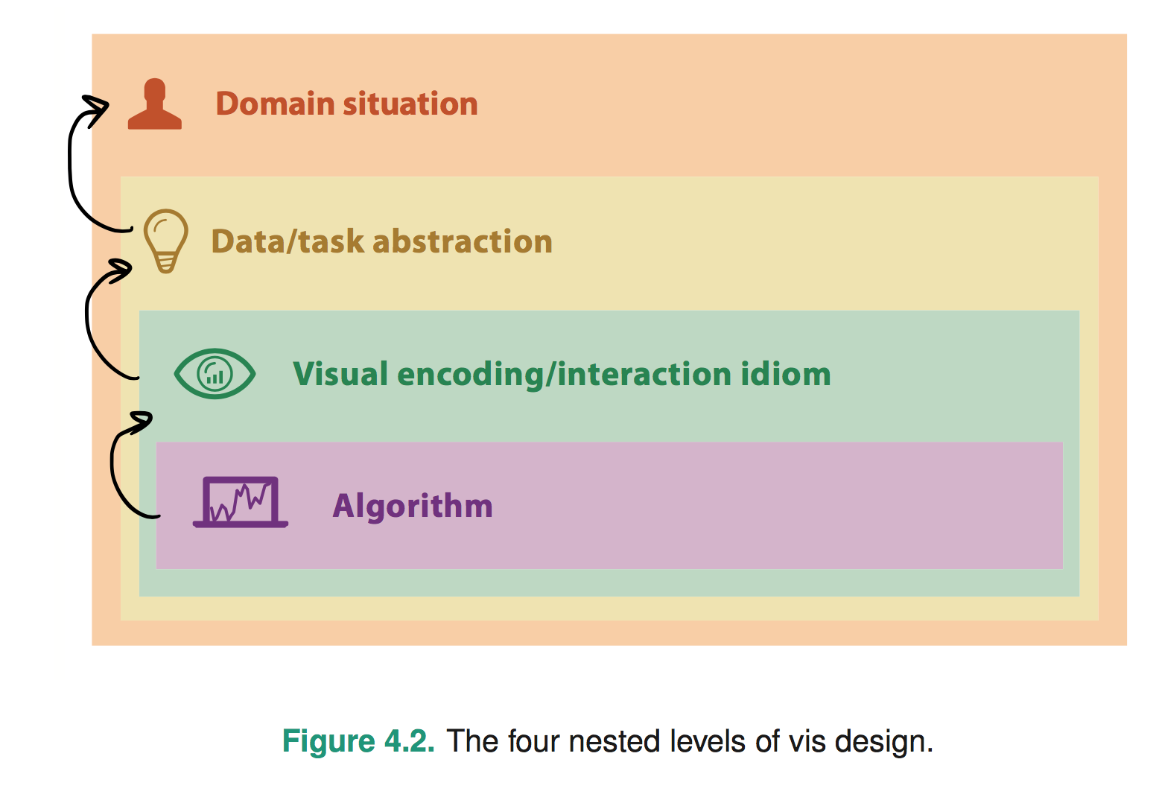
4 classes of questions
Wrong problem. Misunderstood user needs
Wrong abstraction. Showing the wrong thing
The way to show data is ineffective
Code is slow/buggy
Notes:
* early webvis papers soled "lost in hyperspace" by rendering the web's hyperlink topological structures. Not useful, and no idiom/algorithm could solve it, since it only added to user cognitive load

Slide 27
Thoughts on problem & abstraction?
Use case:
what do people want when querying data on-the-go?
Is speaking SQL the best way to query on-the-go?
Improvements/Alternatives?
Mobile-friendly SQL keyboard?
Custom app/visual analytics

Slide 28
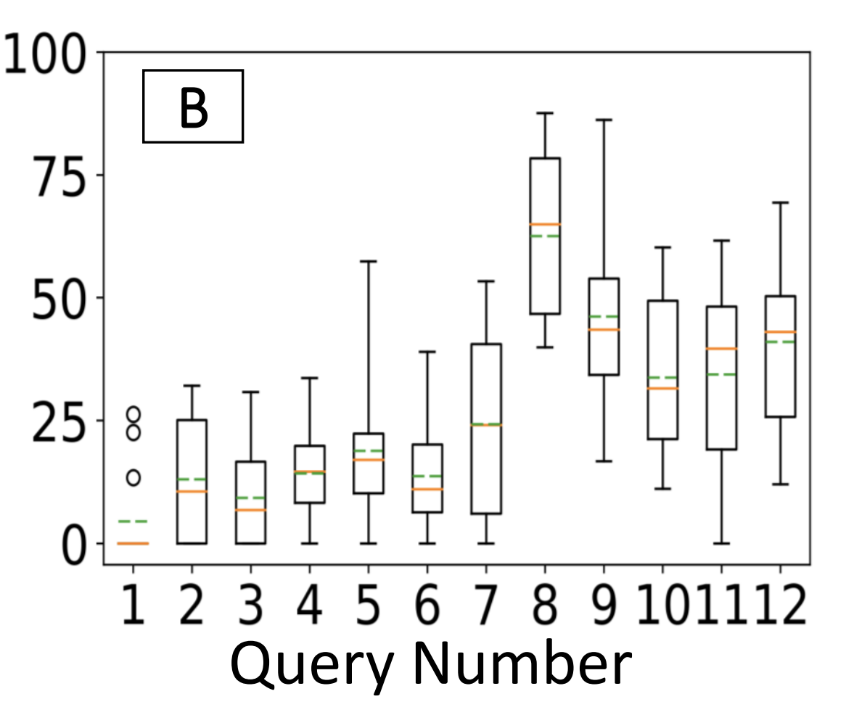
Issues with SpeakQL
Expressiveness
Select-Project-Join-Aggregate (up to 50 tokens)
Challenges if richer language?
debugging query structure harder if nesting is wrong
Intuitiveness
Easy to “debug” query? (lots of keyboard time) →
Need to say “comma” in “SELECT a, b”
% time spent using keyboard

Slide 29
Experiments
Were the experiments “fair”?
Ran a pilot study – good idea!
Not clear what queries/tasks are evaluated
Type SQL using phone keyboard (of course it’s hard!)

Slide 30
GestureQuery, SpeakQL
Both are for simple queries.
GestureQuery for novices,
SpeakQL for “experts”
Do they extend to other types of users?
Floor: how easy to get started/learn?
Ceiling: how complex can tasks be once proficient?
How do they help user understand if query is correct or not?

Slide 31
GestureQuery, SpeakQL
Compare with Tableau
Tableau good at visual analytics and filter/aggregation
Less good at joins, selection
Compare with Excel
Excel good at projection, simple filters, sort
Less good at Joins, complex predicates, aggregation

Slide 32
Dimensions of Data Interfaces
Tasks
Users
Modalities

